Slide 1
A practical review of math and coding Class #5: Interpolation & smoothing

Slide 2
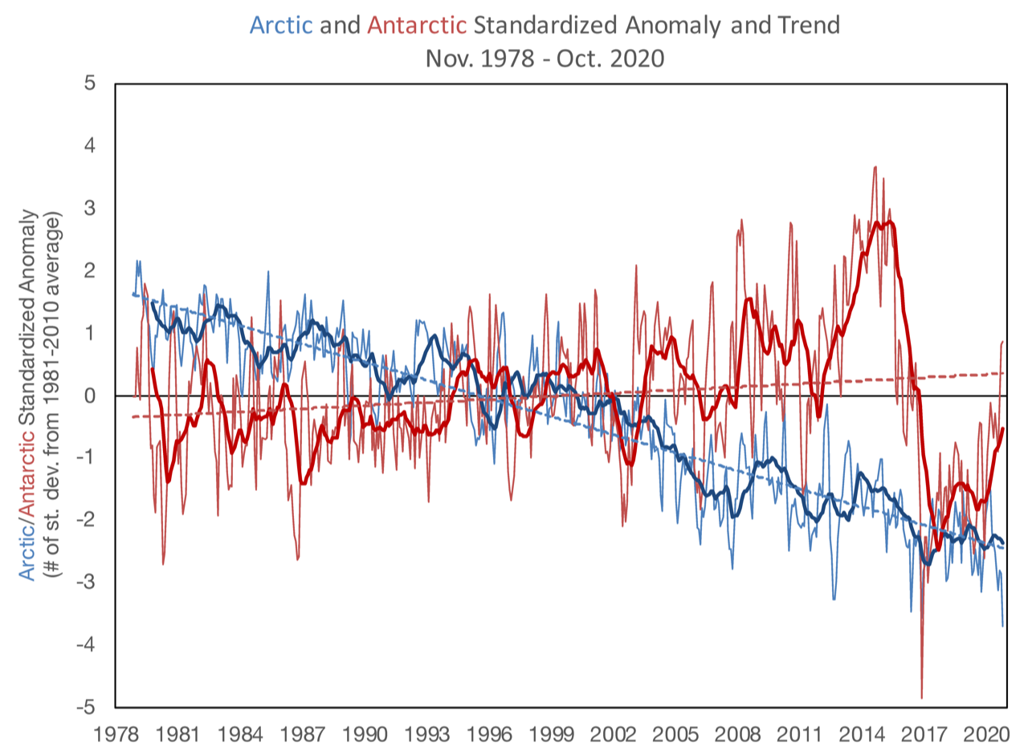
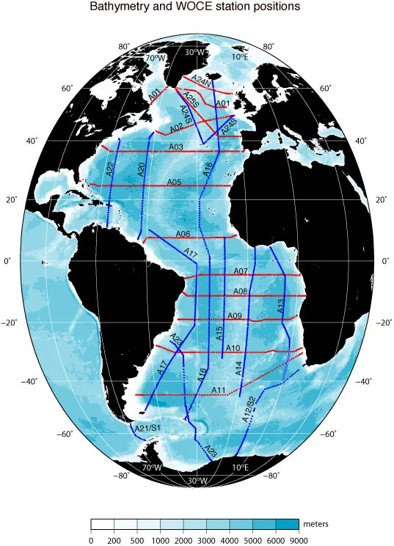
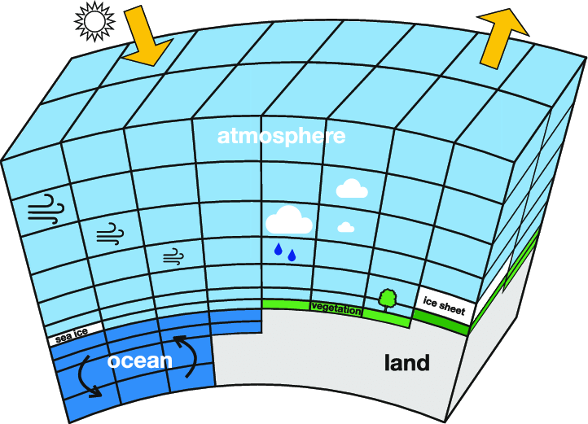
Why interpolate?

Slide 3
We may need to interpolate data when…
Comparing datasets that are defined in different grid system in space and/or in time
Data points are sparse and/or irregular, and it needs to be placed on regular grid before data analysis/interpretation
There is a data gap (missing data) that needs to be filled
Preparing inputs (e.g. boundary conditions) for a model that are continuous, smooth and without gaps

Slide 4
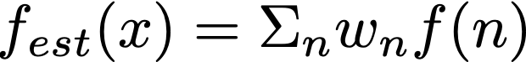
Interpolation as a linear operator
Mathematically,

Slide 5
Interpolation as a linear operator
Mathematically,
Output, e.g. estimated temperature on regular grid
Input, e.g. observed temperature on irregular grid

Slide 6
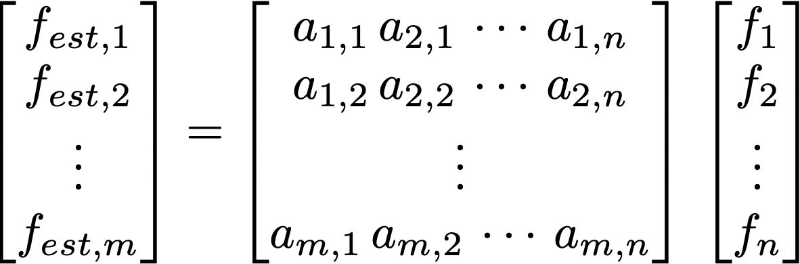
Interpolation as a linear operator
Mathematically,
Output, e.g. estimated temperature on regular grid
Input, e.g. observed temperature on irregular grid

Slide 7
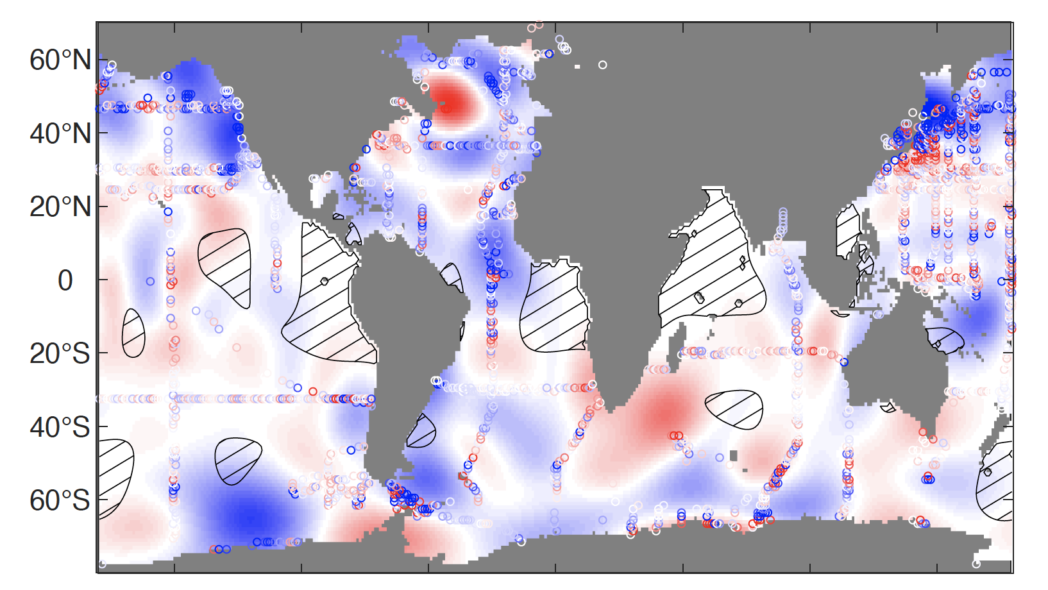
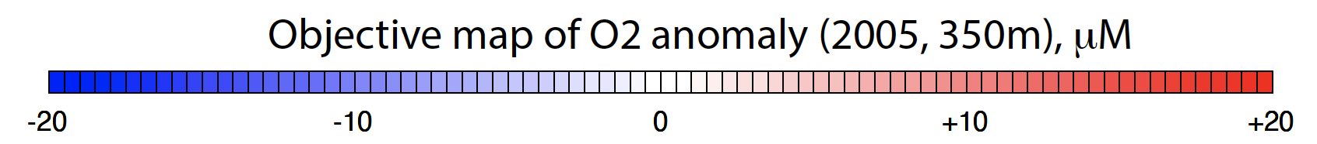
Objective mapping (optimal interpolation)
Objective mapping is a least square fit to the irregular, noisy observations, commonly used in meteorology and oceanography

Slide 8
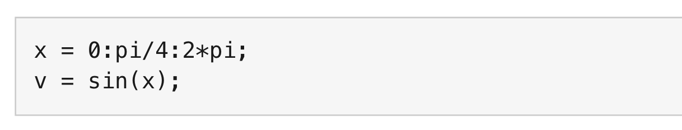
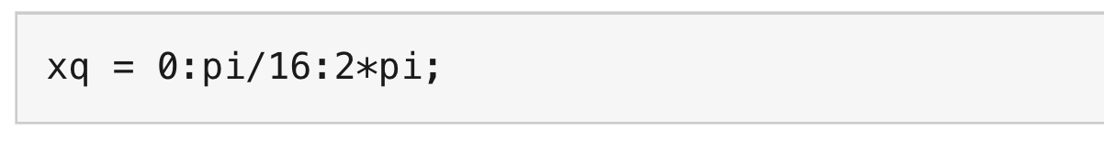
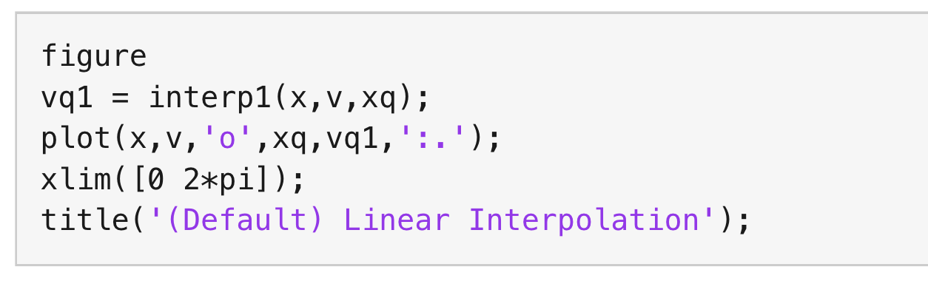
1. piecewise linear (MATLAB)
The input is a sine function subsampled at every π/4
The interpolation output is desired at every π/16
The MATLAB function, interp1, by default give you the piecewise linear interpolation

Slide 9
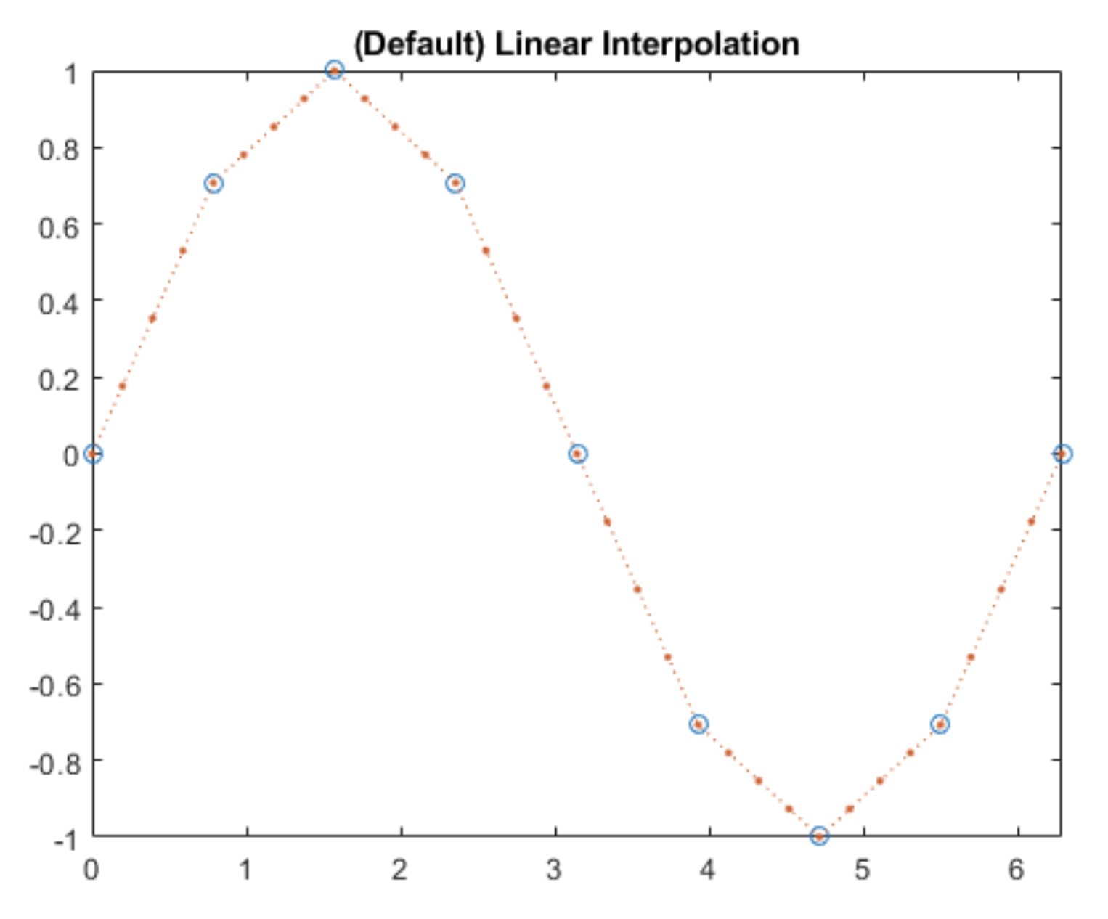
1. piecewise linear (MATLAB)
The input is a sine function subsampled at every π/4
The interpolation output is desired at every π/16
The MATLAB function, interp1, by default give you the piecewise linear interpolation

Slide 10
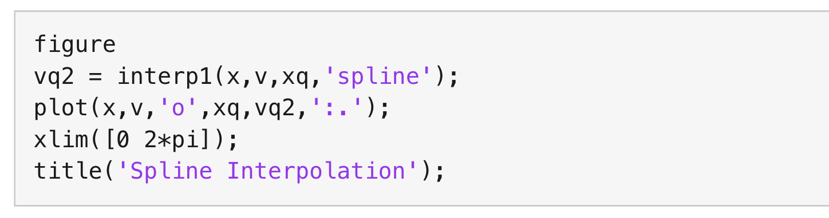
2. spline (MATLAB)
The input is a sine function subsampled at every π/4
The interpolation output is desired at every π/16
See the option ‘spline’ for the input of interp1 function

Slide 11
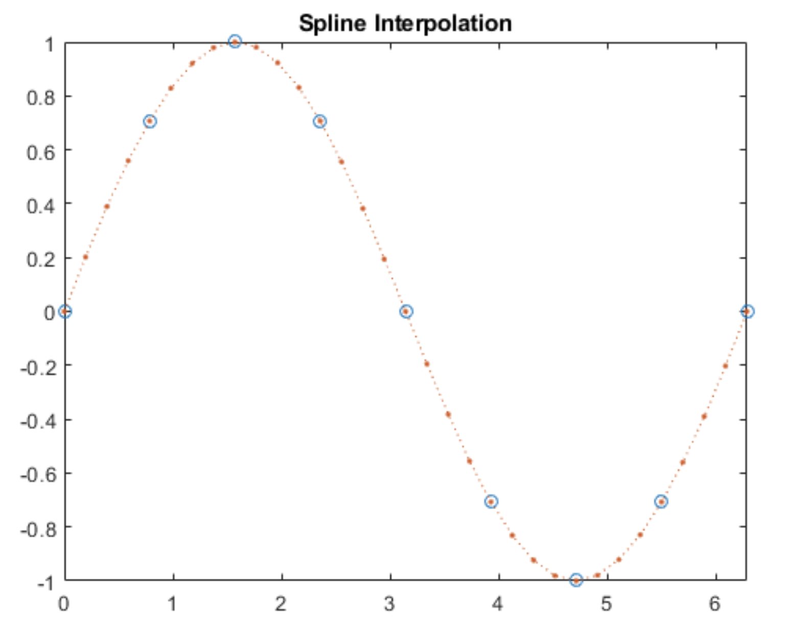
2. spline (MATLAB)
The input is a sine function subsampled at every π/4
The interpolation output is desired at every π/16
See the option ‘spline’ for the input of interp1 function

Slide 12
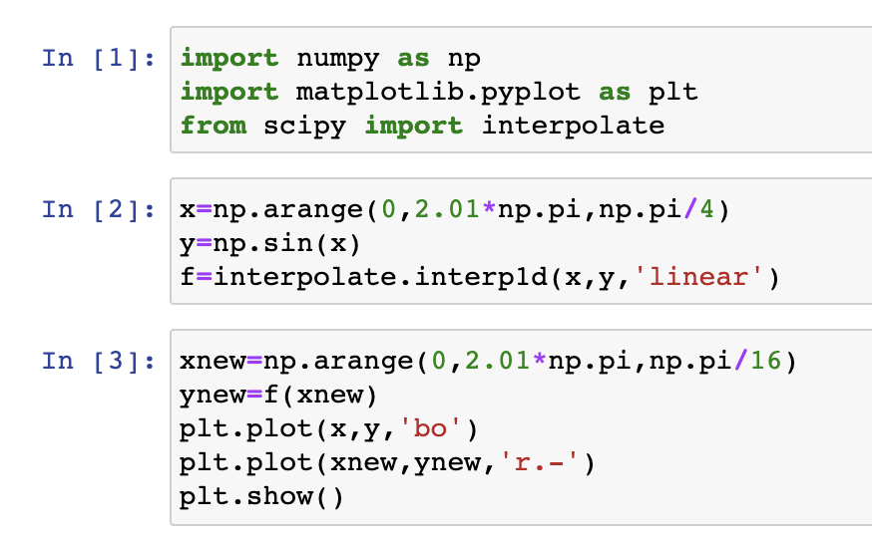
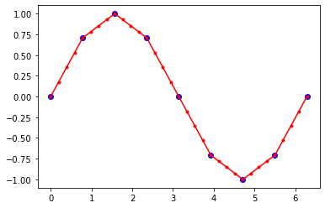
Python: scipy.interpolate.interp1d (linear)

Slide 13
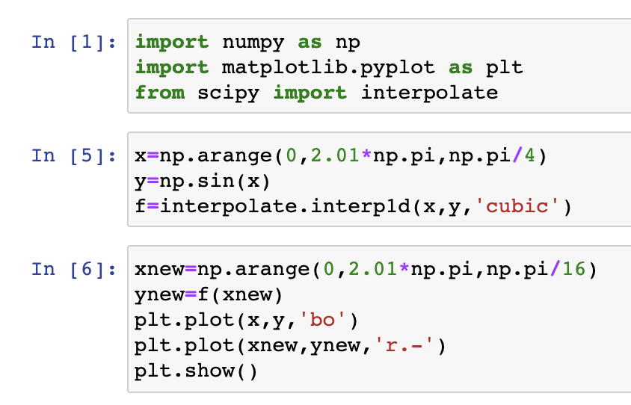
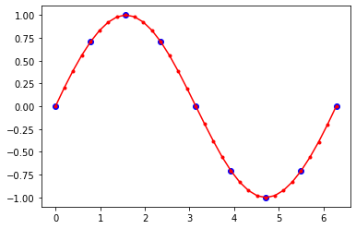
Python: scipy.interpolate.interp1d (spline)

Slide 14
Python: scipy.interpolate.interp1d (spline)

Slide 15
Two dimensional interpolation
Input/output are in 2 dimensions: f(x,y)
Example: Input is a temperature on 2° x 2° longitude-latitude grid and the desired output is on 1° x 1° grid.
Bilinear interpolation → this is what I use for the first try. First, linearly interpolate in one direction, and then linearly interpolate again in the other direction
Other options would be nearest neighbor and cubic spline

Slide 16
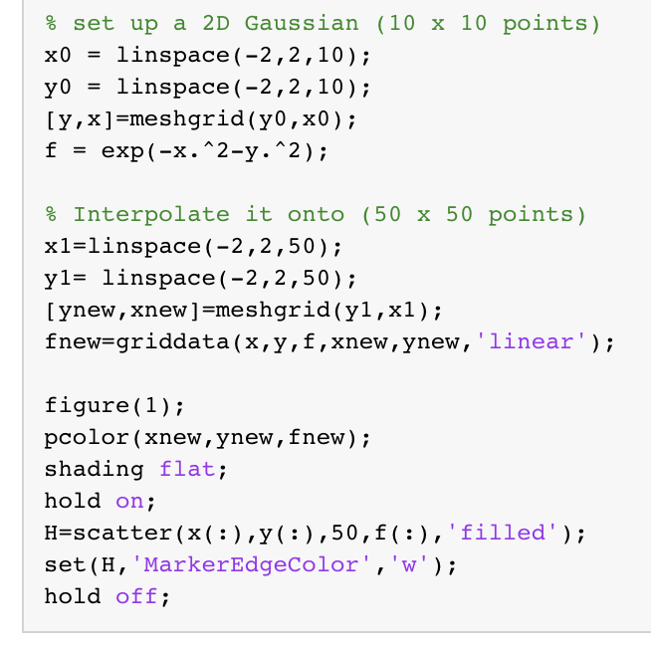
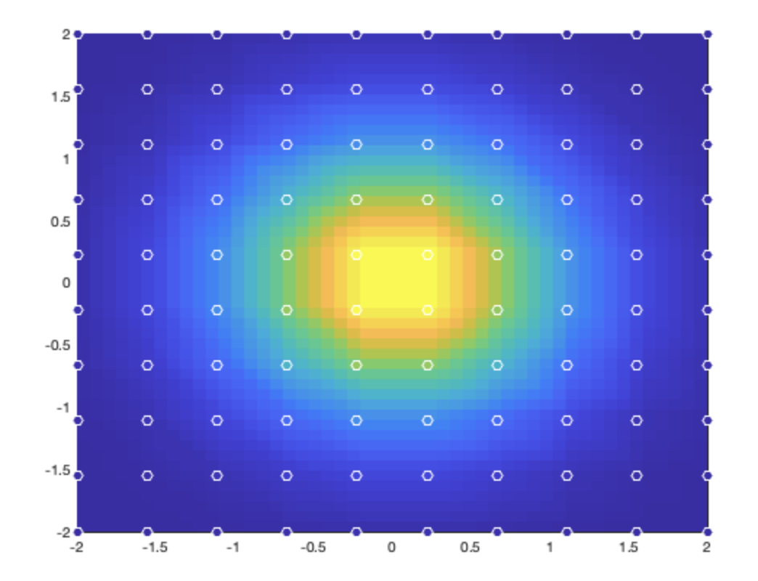
MATLAB: fnew = griddata(x,y,f,xnew,ynew)
Bilinear interpolation

Slide 17
MATLAB: fnew = griddata(x,y,f,xnew,ynew)
Bilinear interpolation

Slide 18
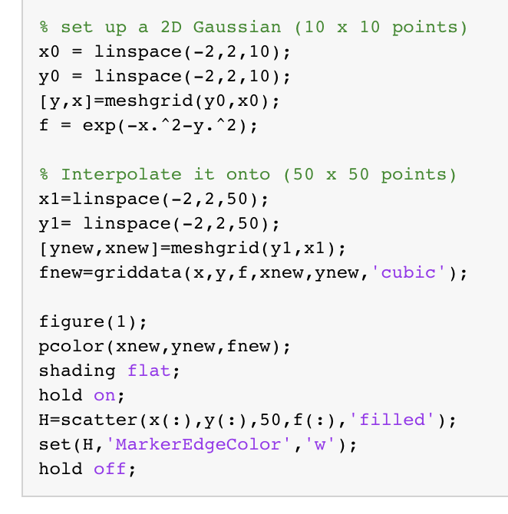
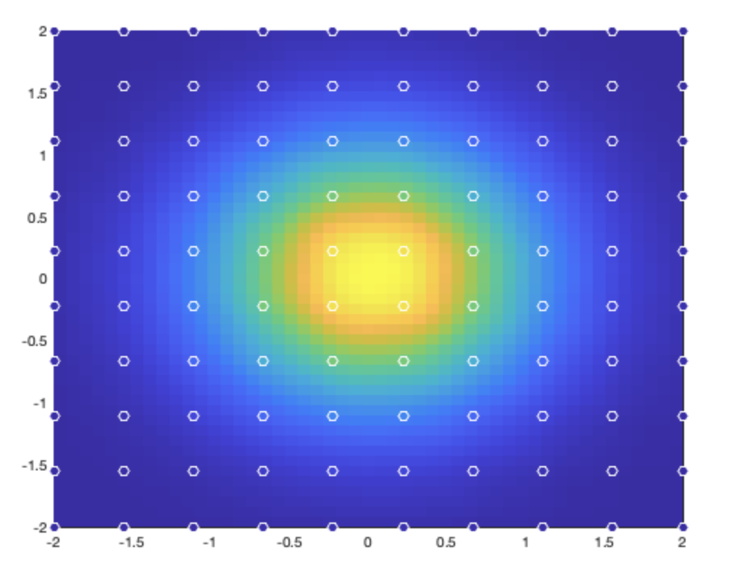
MATLAB: fnew = griddata(x,y,f,xnew,ynew)
Cubic interpolation

Slide 19
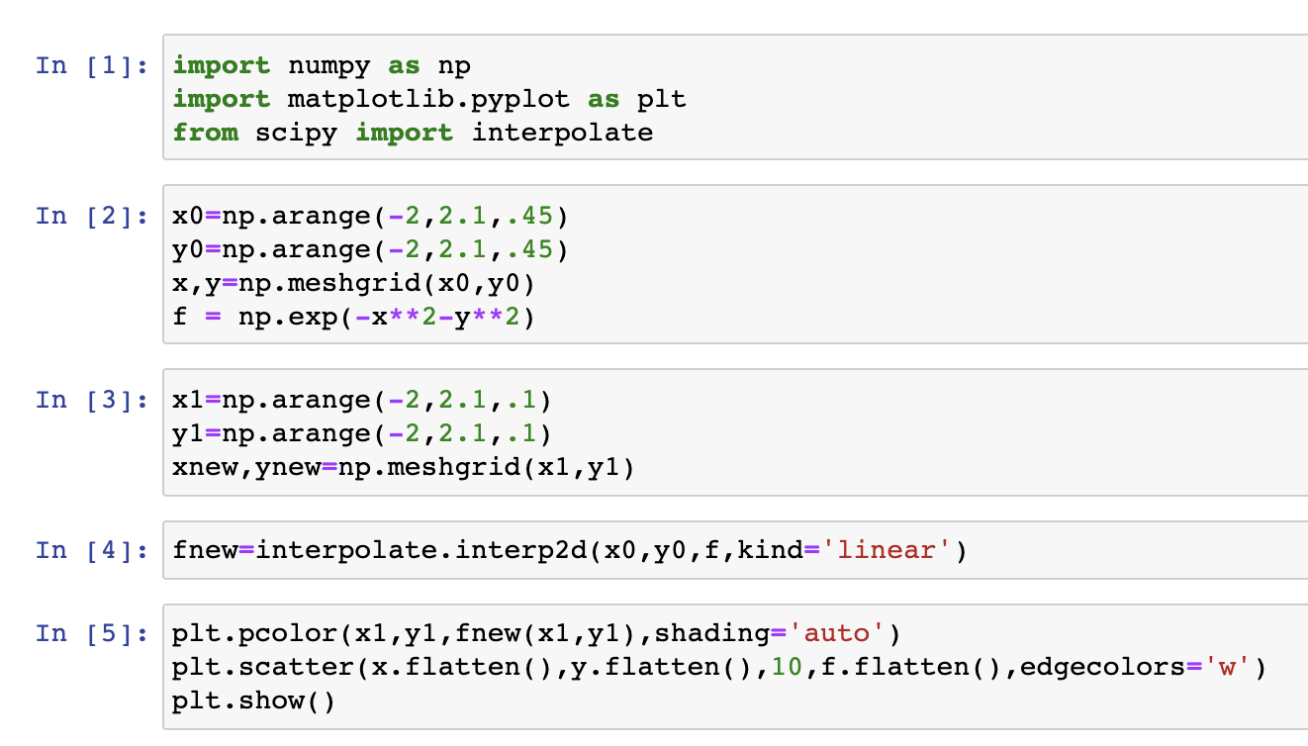
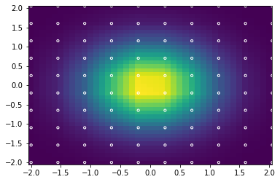
Python: interpolate.interp2d

Slide 20
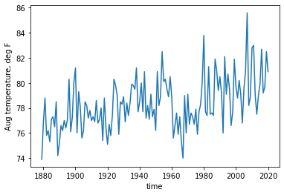
Least square and interpolation
Looking at the August temperature (T) of Atlanta, I expect an increasing trend with time (t). The expected relationship is:
where a₀ and a₁ are constants.
T(t)

Slide 21
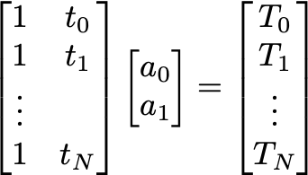
Least square and pseudoinverse
Looking at the August temperature (T) of Atlanta, I expect an increasing trend with time (t). The expected relationship is:
where a₀ and a₁ are constants.
T(t)
A x ~ b

Slide 22
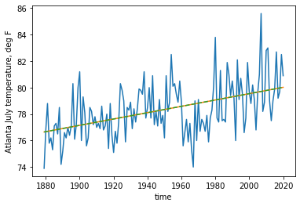
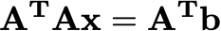
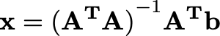
An example
y_{est} = Ax = a₀ + a₁ t
A x = b

Slide 23
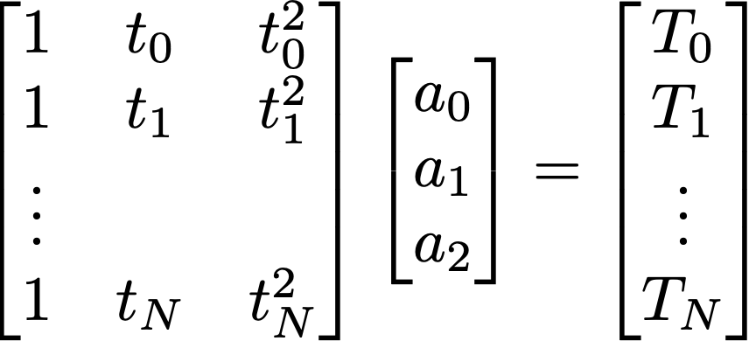

An example
A x = b

Slide 24
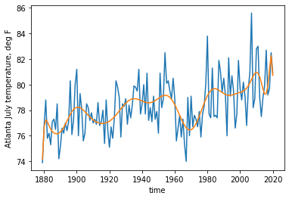
An example
A x = b

Slide 25
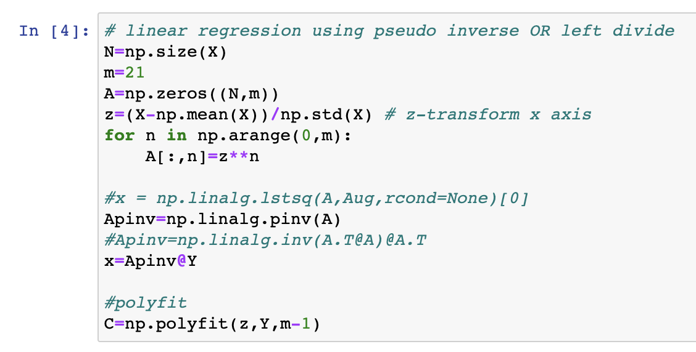
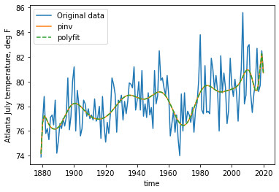
A python example
np.polyfit

Slide 26
A python example
Normalization is often necessary to make this algorithm work for higher order polynomial
np.polyfit

Slide 27
Smoothing
Real data often contains noises.
For example, atmospheric data contains high-frequency weather events on top of slowly varying climate signals. Ocean data can contain the effects of tides, waves, eddies, seasonal cycles etc…
Sometimes, we want to remove the high-frequency “noises” so that we can focus on the slowly varying climate signals.
Smoothing (filtering) is almost necessary step in data analysis

Slide 28
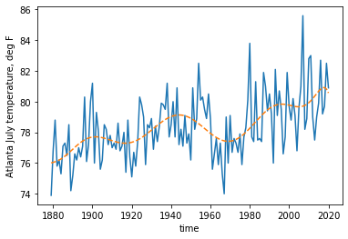
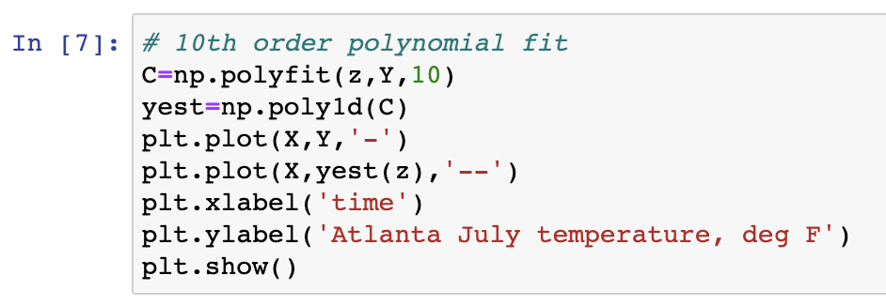
np.polyfit (python) and polyfit (MATLAB)
In python, C = np.polyfit (x,y,n) will calculate the coefficients (C) for n-th order polynomial fit to the data y(x).
Then yest = np.poly1d(C) will create a polynomial function

Slide 29
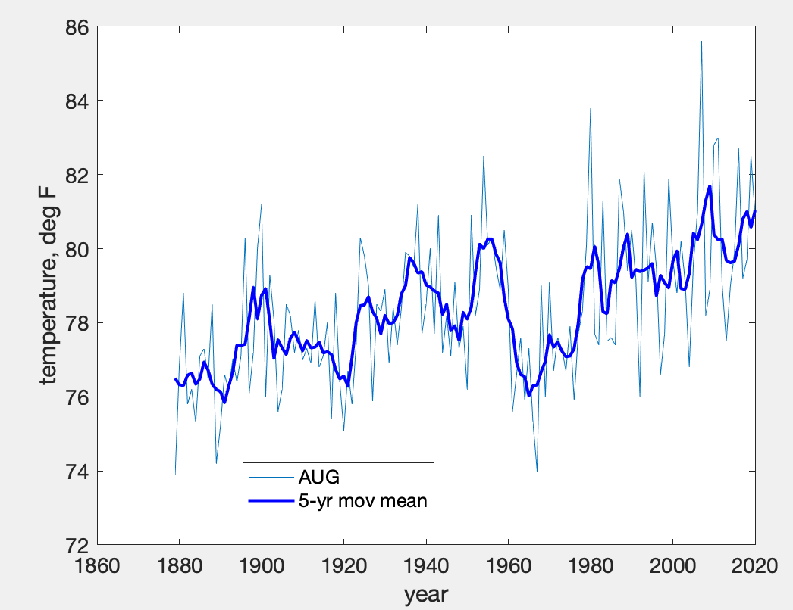
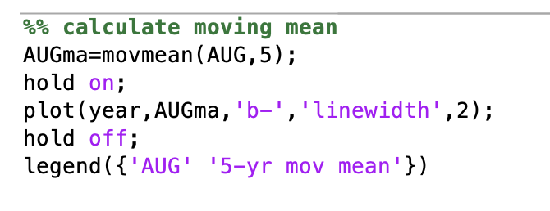
Moving window averages (running mean)
The data is smoothed by averaging over a given time window. For example, we can look at the August temperature of Atlanta, and apply 5-year moving window averaging.
movmean(data,window_size)

Slide 30
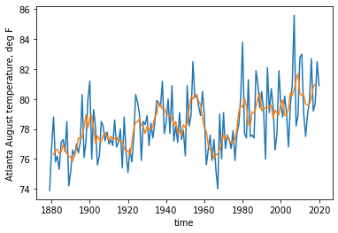
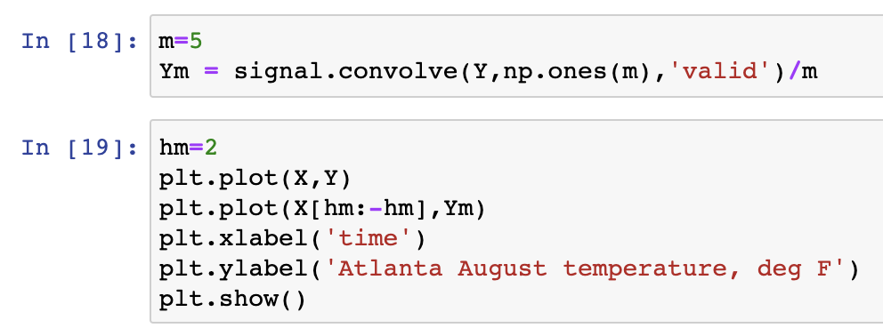
Moving window averages (running mean)
The data is smoothed by averaging over a given time window. For example, we can look at the August temperature of Atlanta, and apply 5-year moving window averaging
(from scipy import signal)

Slide 31
Moving window averages (running mean)
In MATLAB, use movmean
In Python, use scipy.signal.convolve
Running mean can be calculated as a discrete convolution with ones of window size (N) divided by N

Slide 32
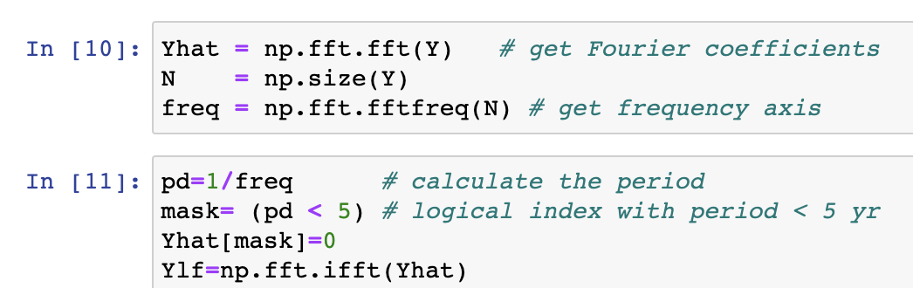
FFT filter
Fourier series → decomposes the data into linear combination of sine and cosine waves
Fast Fourier Transform (FFT) can be used to separate the data into different frequency domain, and ”truncate” the data to chop off certain frequency components

Slide 33
FFT filter
Fourier series → decomposes the data into linear combination of sine and cosine waves
Fast Fourier Transform (FFT) can be used to separate the data into different frequency domain, and ”truncate” the data to chop off certain frequency components

Slide 34
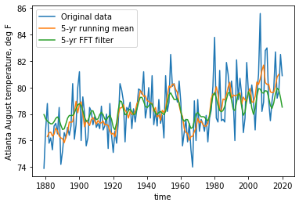
FFT filter
Fourier series → decomposes the data into linear combination of sine and cosine waves
Fast Fourier Transform (FFT) can be used to separate the data into different frequency domain, and ”truncate” the data to chop off certain frequency components

Slide 35
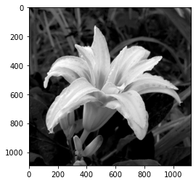
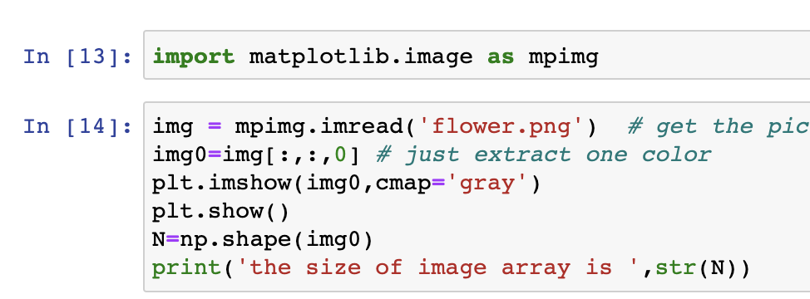
Truncated FFT, smoothing and data compression

Slide 36
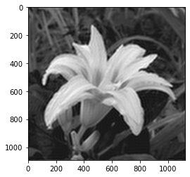
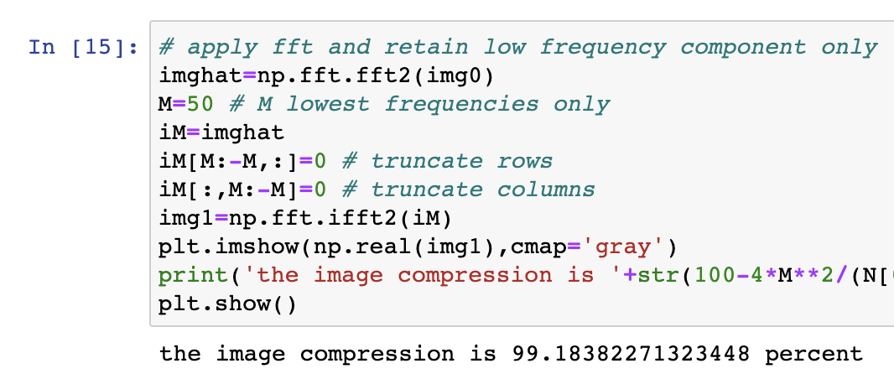
Truncated FFT, smoothing and data compression

Slide 37
Interpolation and smoothing
Practical need to align grid points for validation, comparison, filling data gaps, and model preprocessing etc
Extracting signal from noisy data. Smoothing means we want to focus on low-frequency aspect of the data
Basic understanding of linear algebra machinery (\), pinv, linalg.lstsq, polyfit, convolve (movmean for MATLAB), and fft

